Slide 1

SAP Data Intelligence
ML Based Training

Slide 2
SAP Data Intelligence

Slide 3
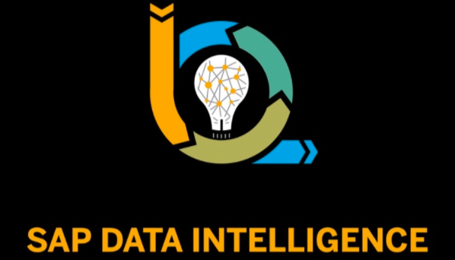
What is SAP Data Intelligence
Why SAP Data Intelligence
How SAP DI helps in Data Integration, Data Processing and Data Catalogue
SAP Data Intelligence Cloud Orchestration

Slide 4
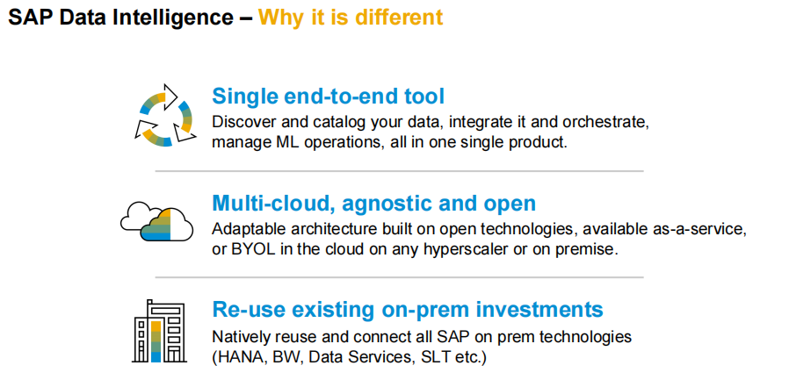

Slide 5
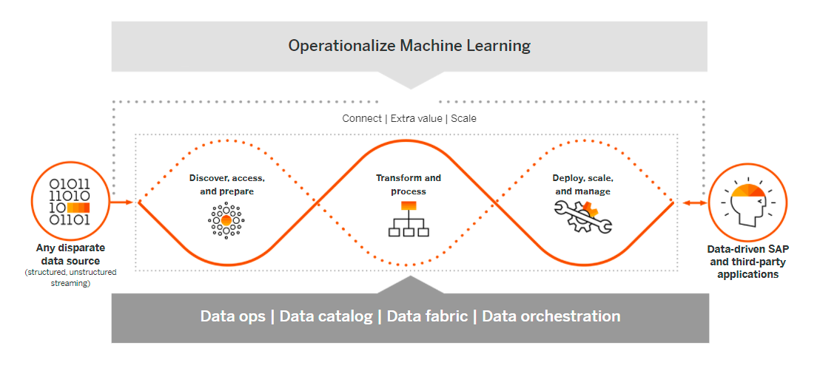

Slide 6
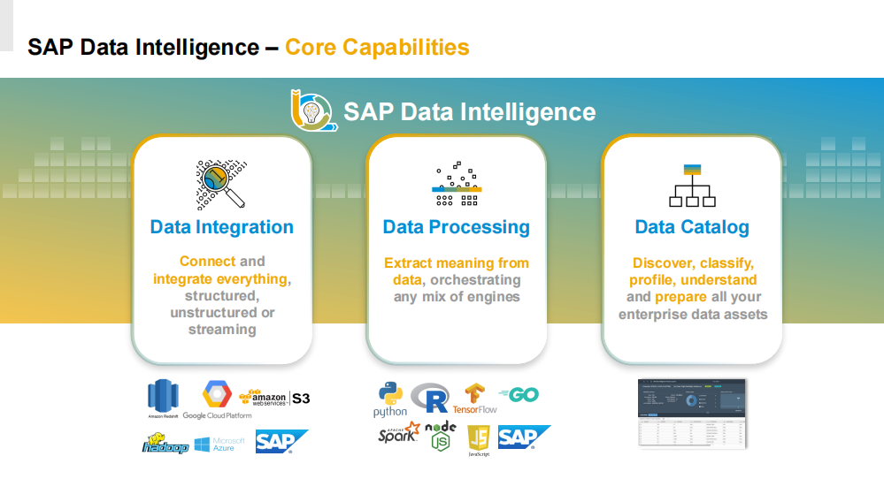

Slide 7
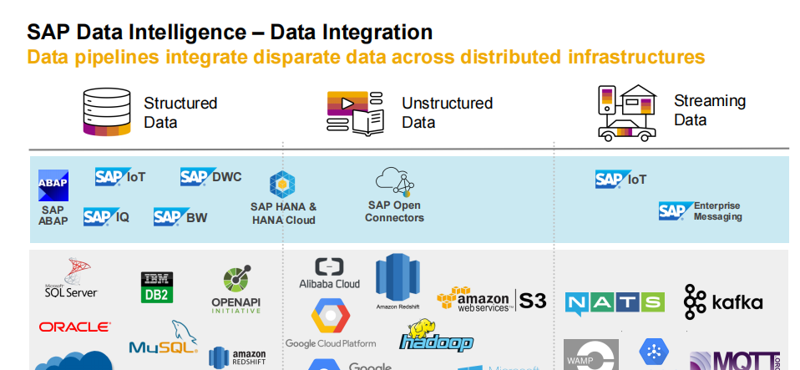

Slide 8
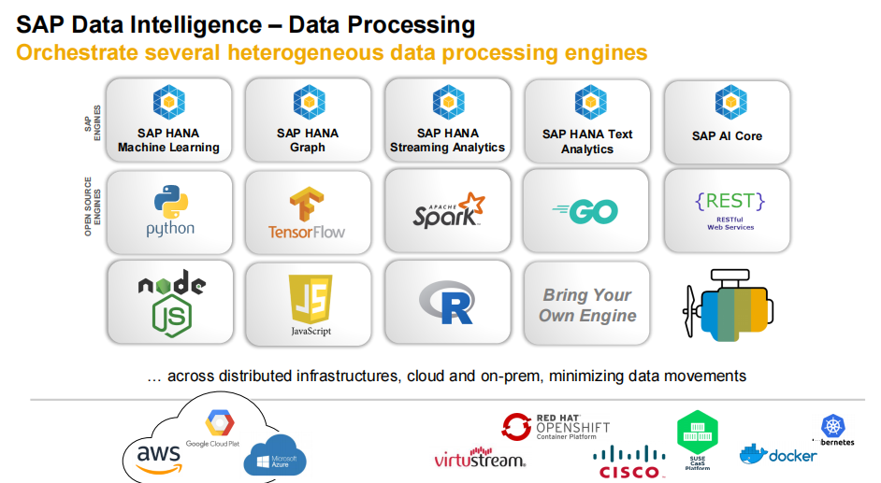

Slide 9
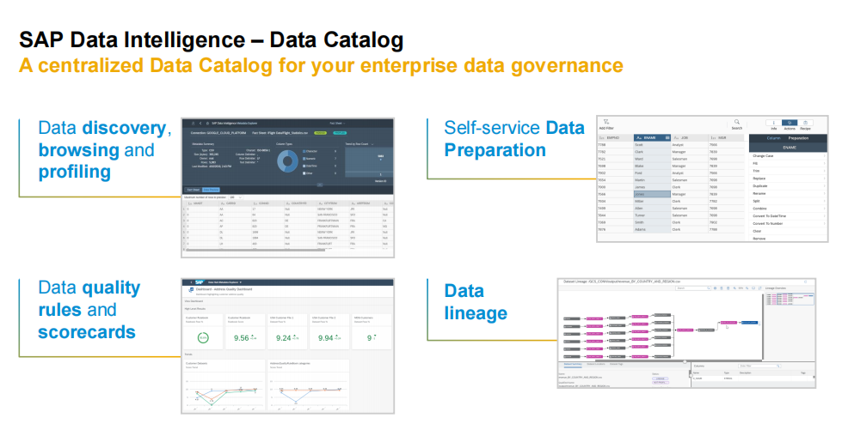

Slide 10
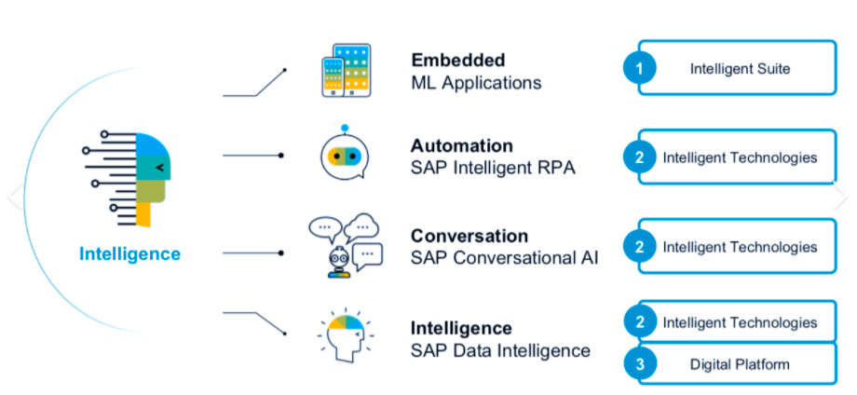

Slide 11
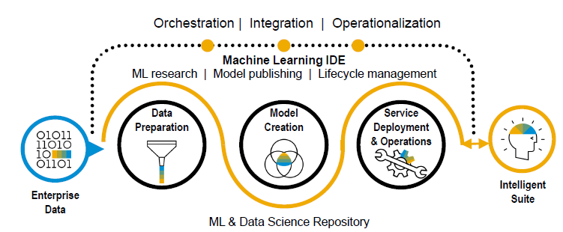
SAP Data Intelligence
Overview:
Deliver data intelligence with AI and information management.
Enable data-driven innovation and intelligent processes with data orchestration and machine learning services.
Machine Learning Life cycle management along with Model/Code management.
Orchestration + Integration + Operationalization

Slide 12
SAP Data Intelligence Architecture

Slide 13
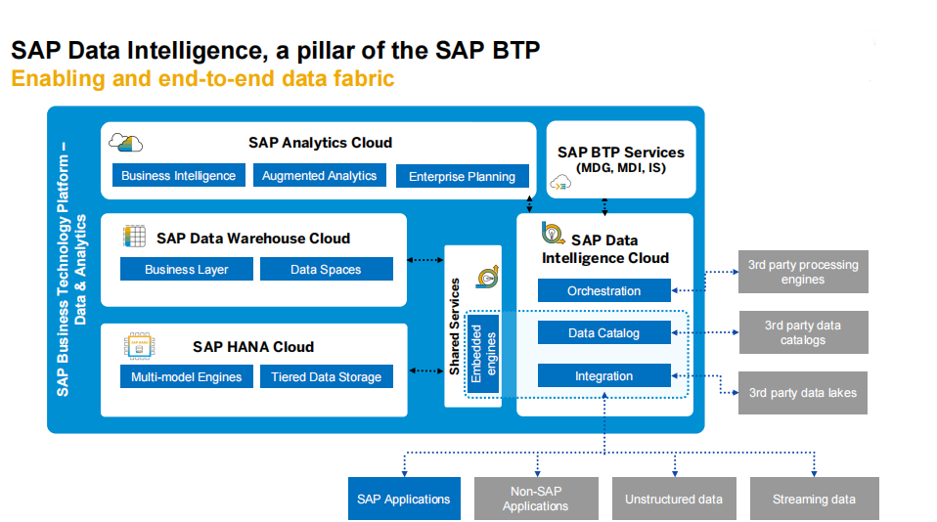

Slide 14
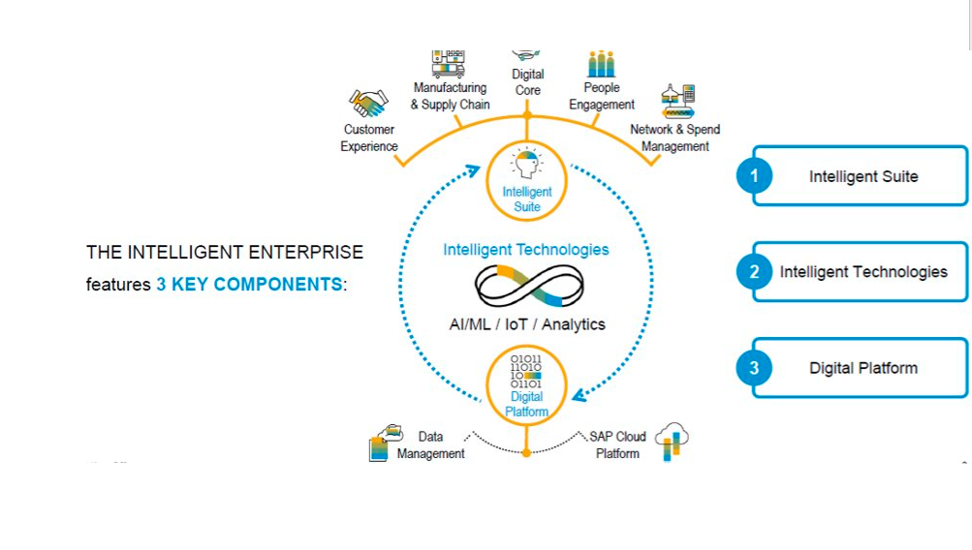

Slide 15
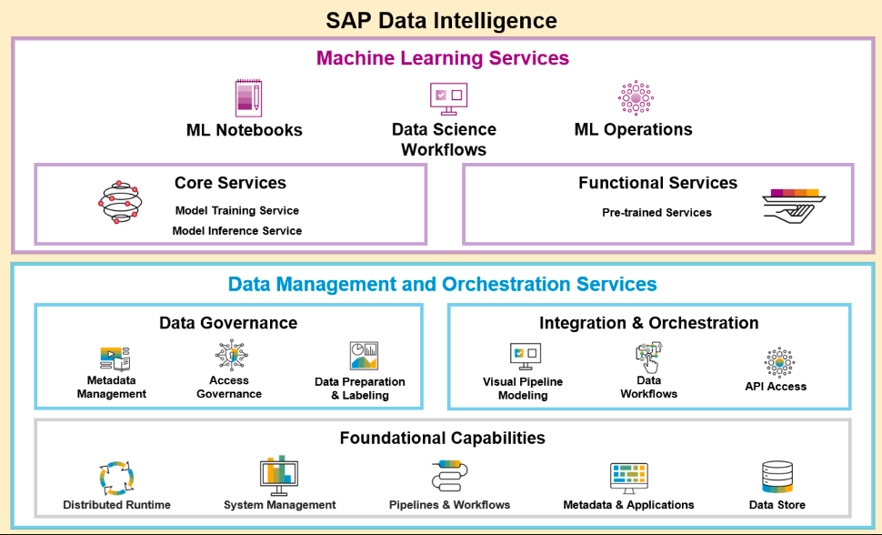

Slide 16
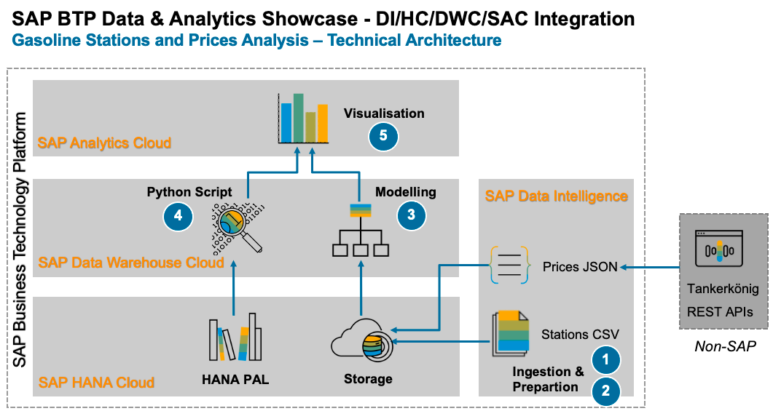

Slide 17
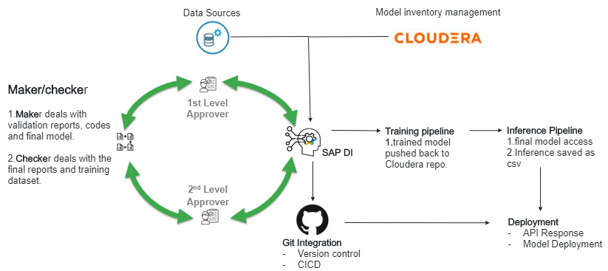
Banking client – ML Model governance use case

Slide 18
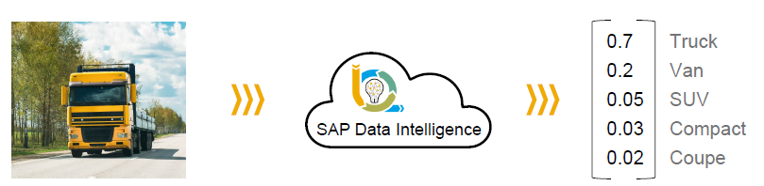

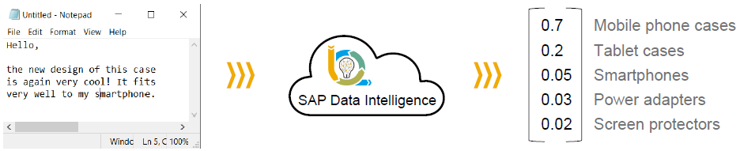
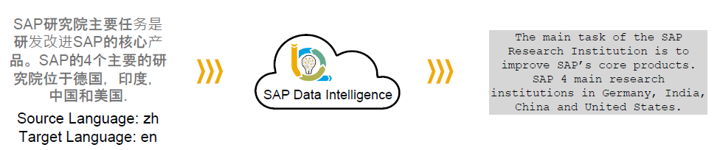
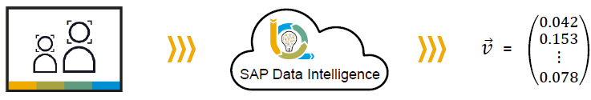
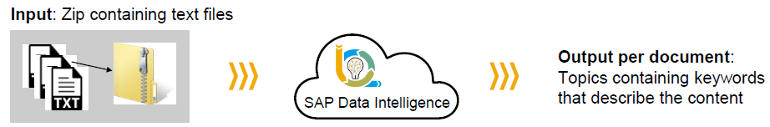
SAP DI In Built AI Services
Image Classification Image Object Character Recognition (OCR):
Text Classification: Translation
Image feature Extraction: Topic Detection:

Slide 19
SAP Data Intelligence Demo

Slide 20
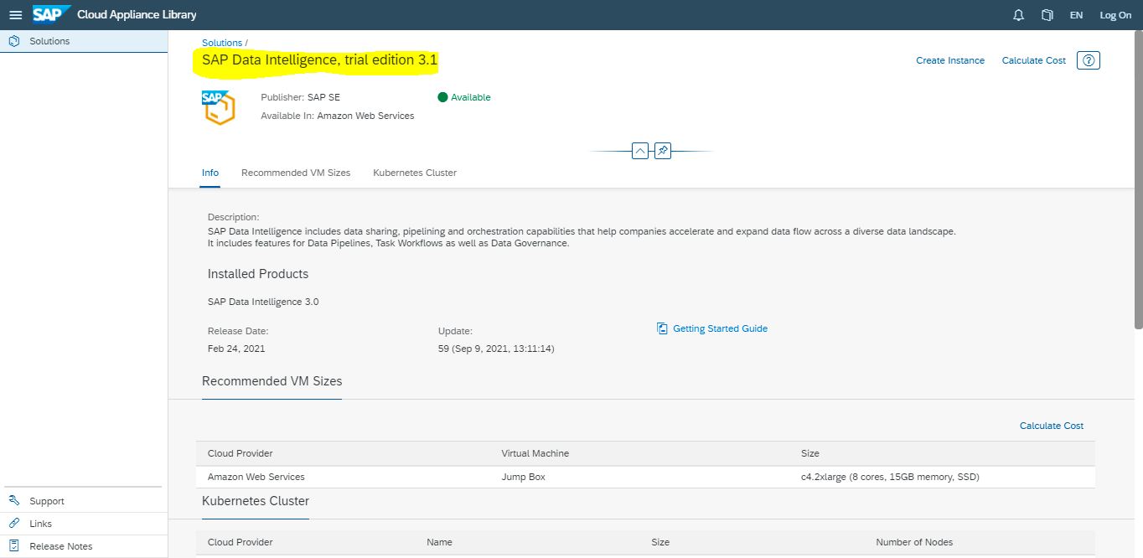
SAP Data Intelligence Trail Account
SAP DI can be accessed through Trail account which is a pre-configured SAP DI landscape for testing and evaluating Data Intelligence applications.
SAP DI trail account is cloud-based appliance library which currently exists public cloud accounts on Amazon AWS, Microsoft Azure and Google Cloud Platforms.

Slide 21
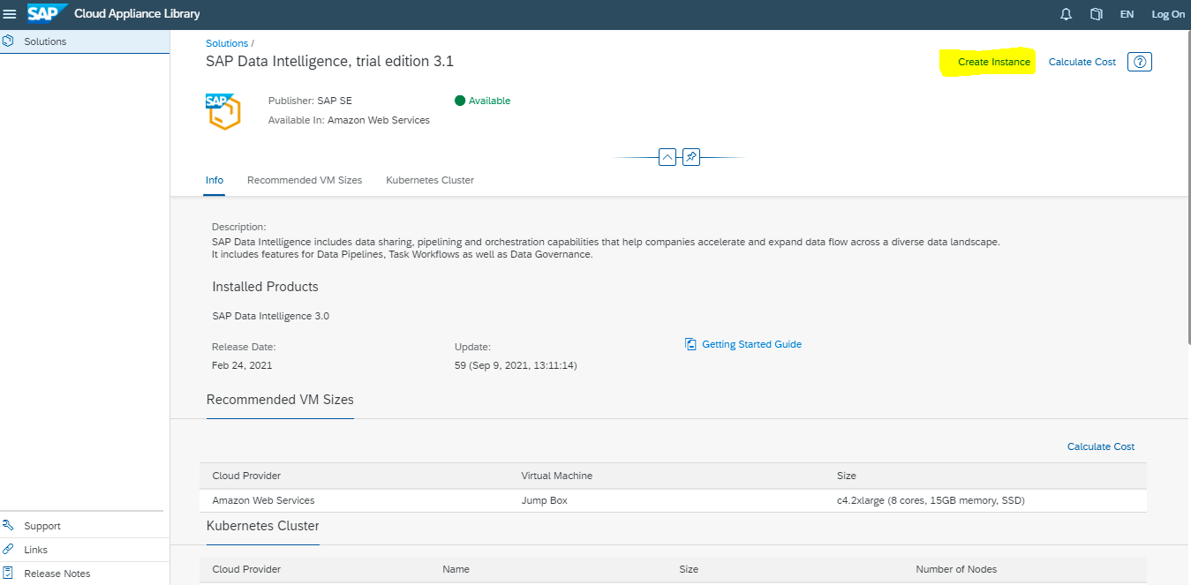
Creating a Solution Instance

Slide 22
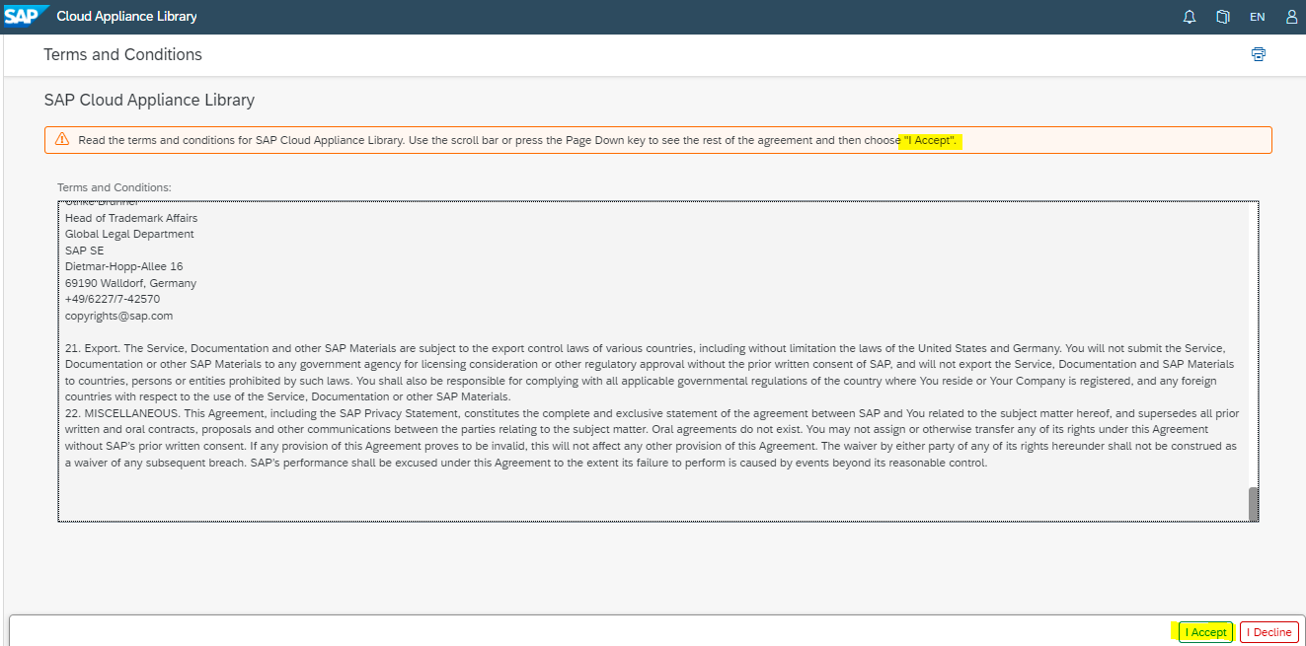

Slide 23
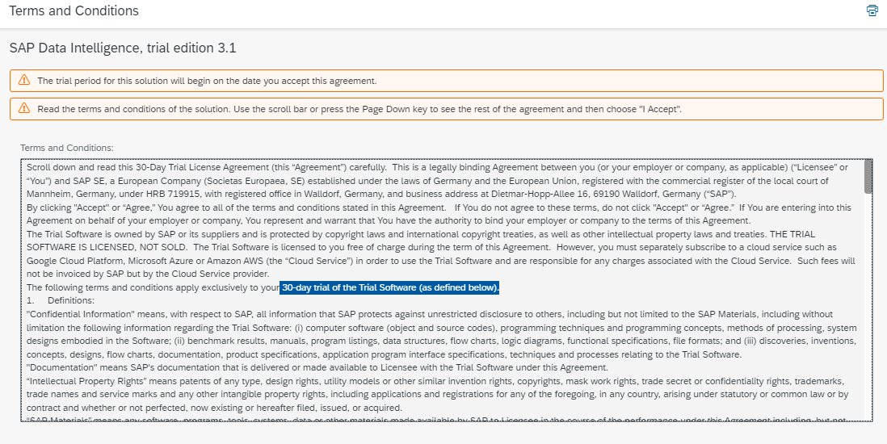

Slide 24
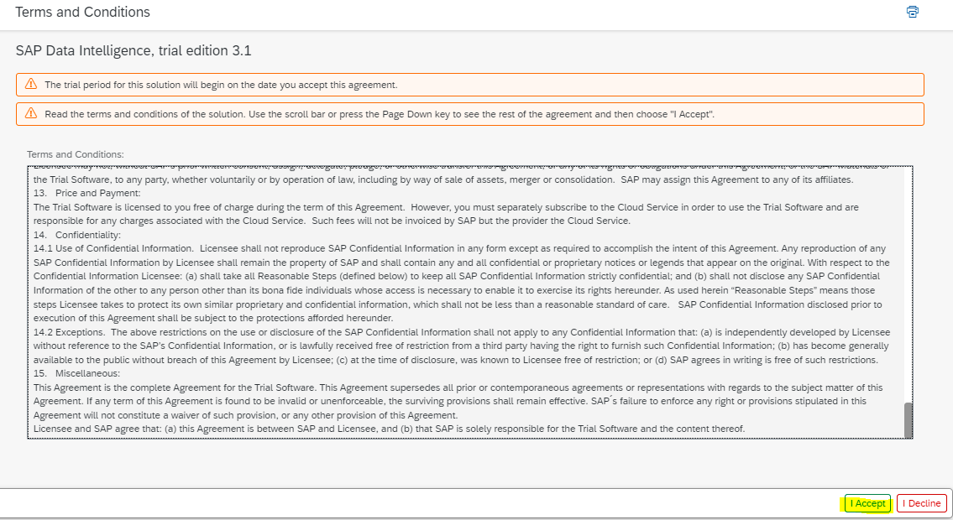

Slide 25
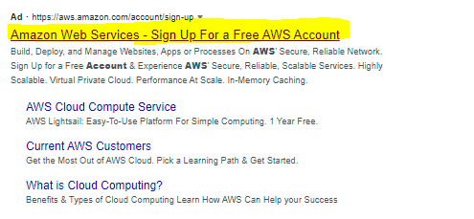

Slide 26
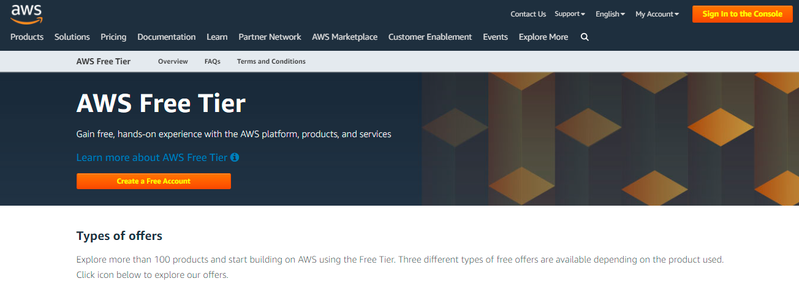

Slide 27
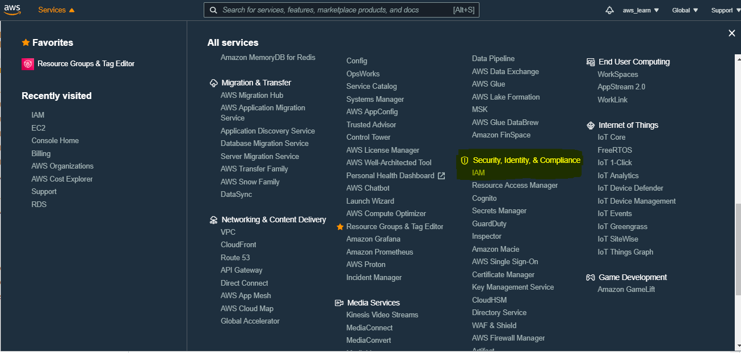

Slide 28
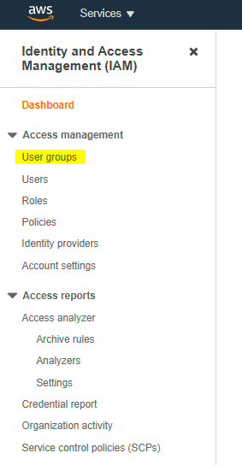
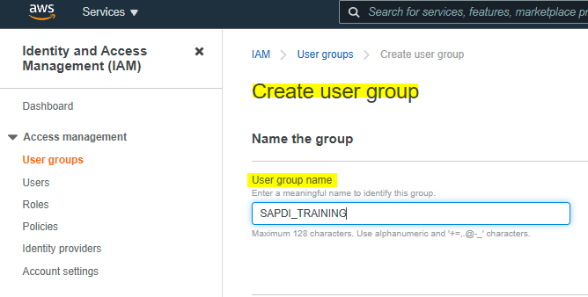

Slide 29
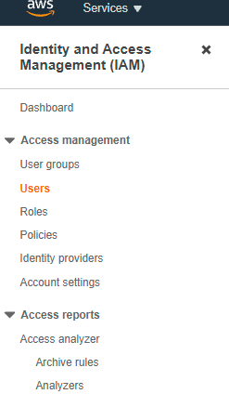
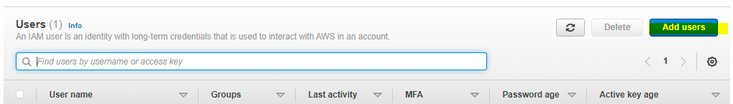

Slide 30
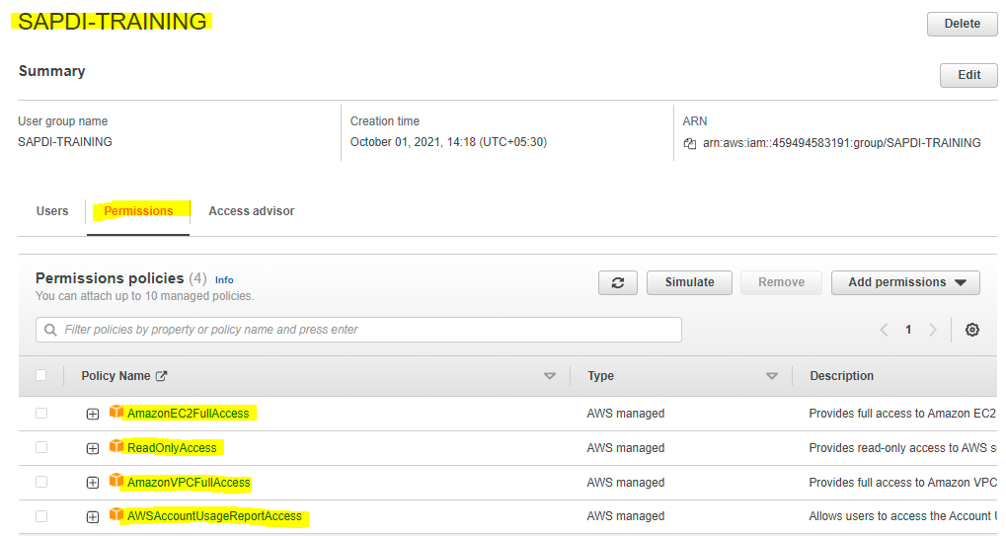

Slide 31
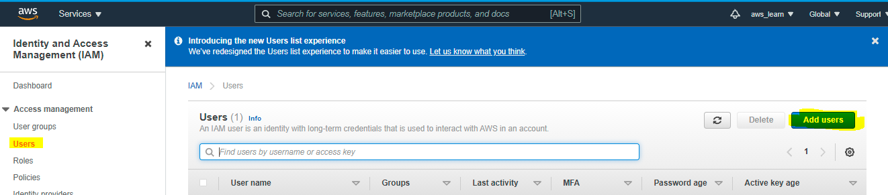

Slide 32
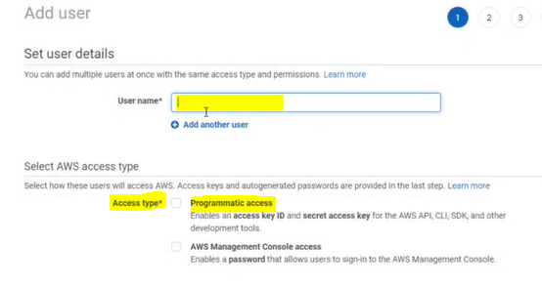

Slide 33
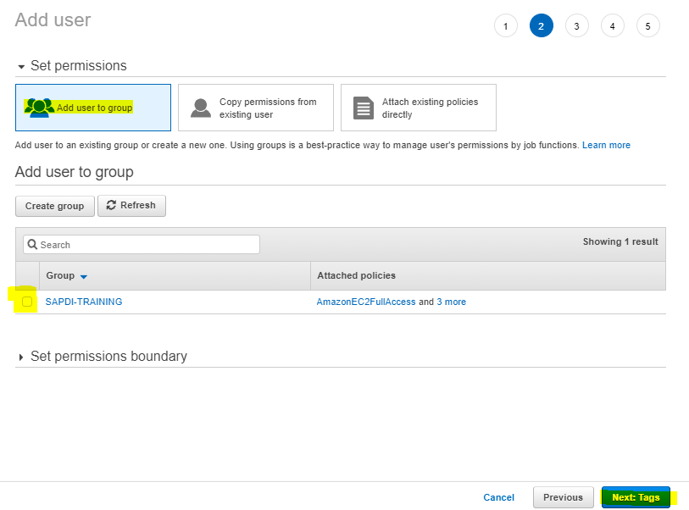

Slide 34
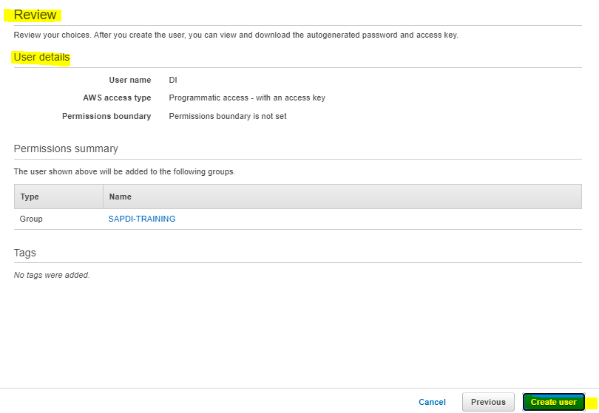

Slide 35
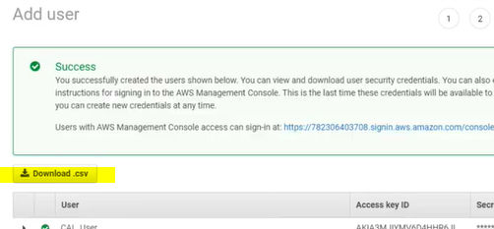

Slide 36
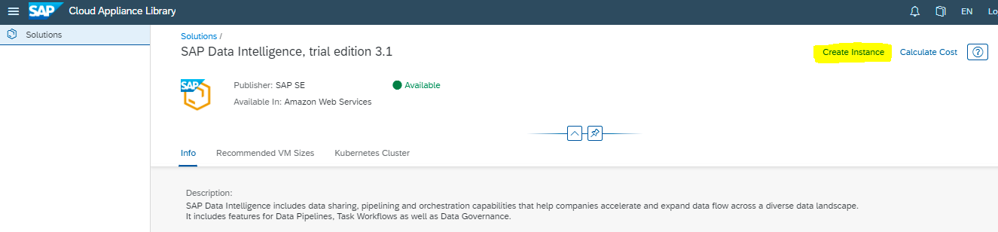
Go to Cloud Appliance Library & Create Instance

Slide 42
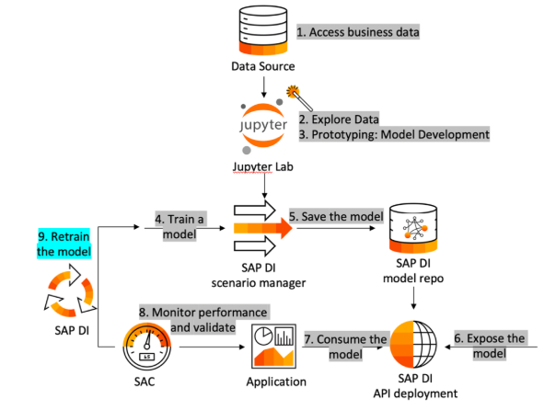
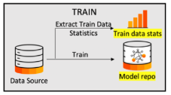
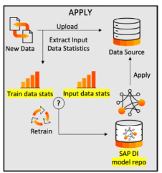
SAP DI ML Flow

